Slide 1
ENGG404 – Lecture Chapter 7.1: The Importance of Culture & Making Everyone a Leader in Safety
Fundamentals of RM
RM System and Process
Leadership in RM
Incident Investigation
RM Tools & Challenges
RM in Industry
People & Org.
Application and Perspectives
On becoming a leader in Risk Management

Slide 2
Learning Outcomes:
Explain the “Three Tenets of Risk Management”.
Explain the “The Incident Pyramid” and the relationship between its layers, and that its set of ratios is not an absolute.
Explain the concept that performance is based on safety culture.
Infer the safety culture of an organization based on its metrics.
Chapter 7.1: Importance of Culture & Making Everyone a Leader in Safety
2
Notes:
2

Slide 3
Three Tenets of Risk Management:
Incidents occur, and are regularly reported in the media.
These losses cannot be denied nor diminished.
Incidents are a source of learning, but this is a hard way to learn.
Incidents are a tragedy, but the greater tragedy would be NOT to learn from them.
All incidents are unacceptable and all are preventable!
Our position and stature as a leader require us to espouse this belief, and diligently work towards preventing all incidents.
These tenets, our beliefs as leaders in risk management, are the base on which we create our values and shape the culture of our organizations.
Chapter 7.1: Importance of Culture & Making Everyone a Leader in Safety
3

Slide 4
The Incident Pyramid, per Frank Bird, ILCI:
Bird, Frank E., and Loftus, Robert G., Loss Control Management, International Loss Control Institute, 1976.
For our purposes, use the ratios (1 : 10 : 30 : 600 : 10,000) as shown above.
Chapter 7.1: Importance of Culture & Making Everyone a Leader in Safety
4
Notes:
4

Slide 5
Incidents with Consequence vs. Incidents with No Consequence:
Chapter 7.1: Importance of Culture & Making Everyone a Leader in Safety
5
Notes:
5

Slide 6
The Shape of the Incident Pyramid:
Ratios vary wildly because:
the degree of observations and self-reporting on substandard conditions and substandard practices;
the extent of reporting incidents such as near miss incidents (close calls);
the extent of reporting minor incidents;
the extent of reporting major incidents.
The “culture” of the company defines what is reported:
Superior-performing companies have processes in place to report incidents with “no consequences”.
Inferior companies only report what is required by law e.g. fatalities, major fires.
Chapter 7.1: Importance of Culture & Making Everyone a Leader in Safety
6
Notes:
6

Slide 7
Proactive Action versus Reactive Response:
Chapter 7.1: Importance of Culture & Making Everyone a Leader in Safety
7
Notes:
7

Slide 8
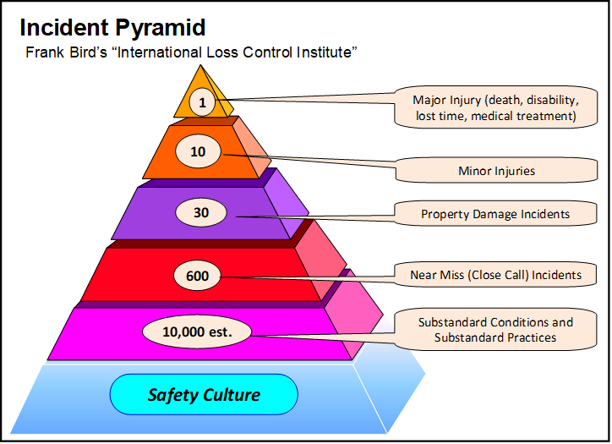
Relationship Between Safety Culture and The Incident Pyramid:
If you have a safety culture that addresses sub-standard conditions and work practices, it reduces the number of near misses, incidents and injuries up the pyramid.
Chapter 7.1: Importance of Culture & Making Everyone a Leader in Safety
8
Notes:
8

Slide 9
Relationship Between Safety Culture and The Incident Pyramid:
Addressing all of the above demonstrates the desired safety culture, and positively influences – synergizes – safety culture.
Chapter 7.1: Importance of Culture & Making Everyone a Leader in Safety
9
Notes:
9

Slide 10
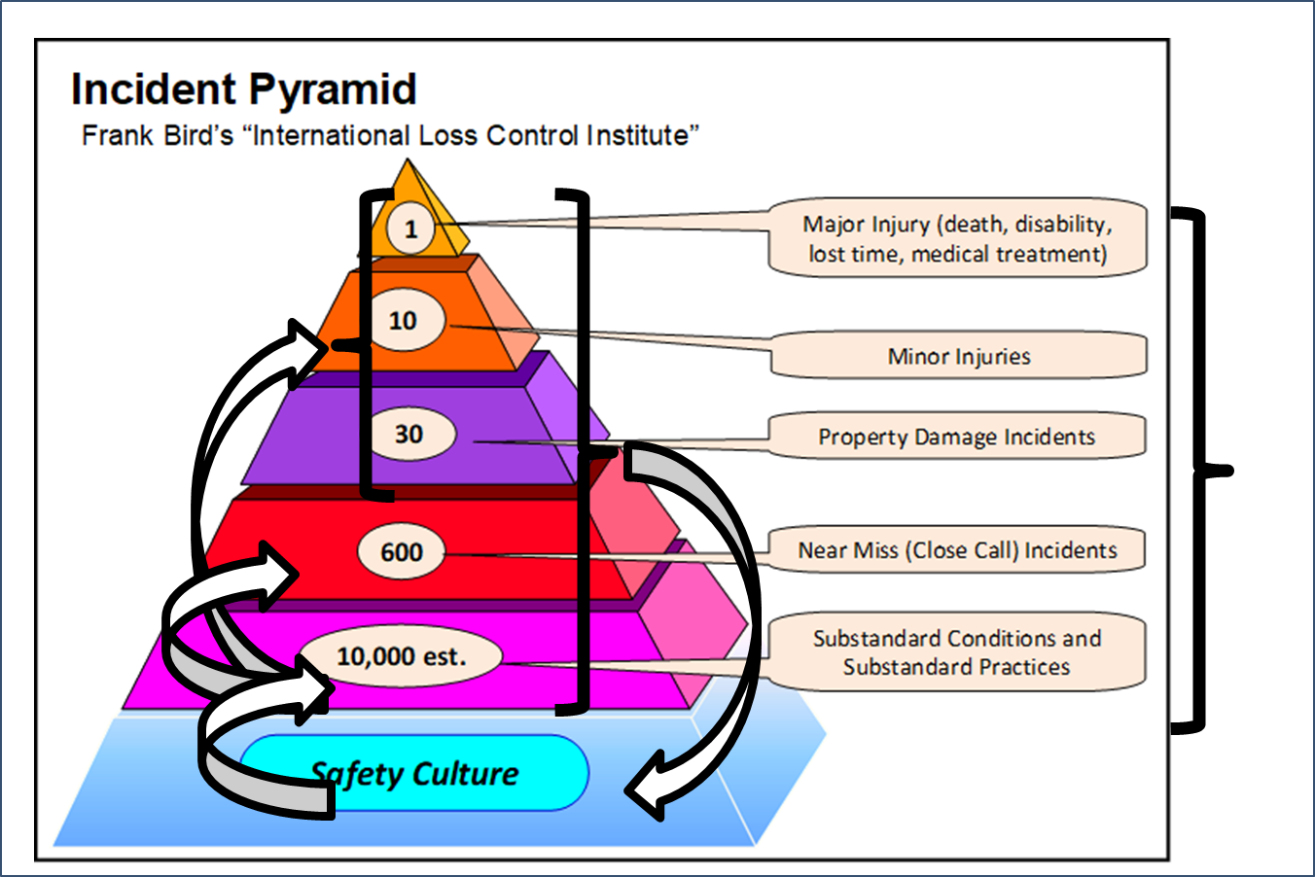
Summary & Key Lessons:
Three Tenets of Risk Management:
Incidents occur.
Incidents are a hard way to learn.
All incidents are unacceptable and all are preventable!
Safety Culture affects Safety Performance.
Chapter 7.1: Importance of Culture & Making Everyone a Leader in Safety
10
Notes:
10

